Slide 1
Quantum Computing Architectures (EE274) Lecture 7
Hiu-Yung Wong
feb. 13, 2025
hiuyung.wong@sjsu.edu, Office: ENG363
http://www.sjsu.edu/people/hiuyung.wong/index.html

Slide 2
Outline
Density Matrix
Bloch’s Sphere

Slide 3
Announcements
2/20 Thursday class will be recorded.
Please work on assignment 1.

Slide 4
Density Matrix
Chapter 6 of “Quantum Computing Architecture and Hardware for Engineers: Step by Step”
Introduction to Quantum Computing From a Layperson to a Programmer in 30 Steps – YouTube
https://www.youtube.com/playlist?list=PLnK6MrIqGXsJfcBdppW3CKJ858zR8P4eP

Slide 5
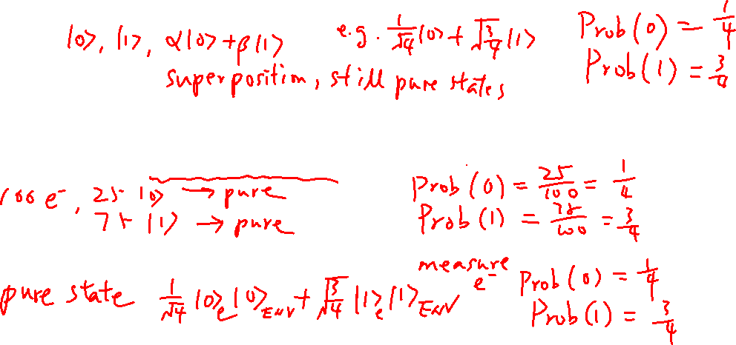
Pure States and Mixed States
From last lecture
Learning outcomes: Pure state can be a linear combination of the basis states
Every quantum system must be in a pure state
Can be accurately described by a wavefunction/state
But sometimes we don’t have a complete knowledge of the system (mixed states)
It is an ensemble of pure states
It interacts/entangled with the environment (an open system) and we cannot describe it as an pure state

Slide 6
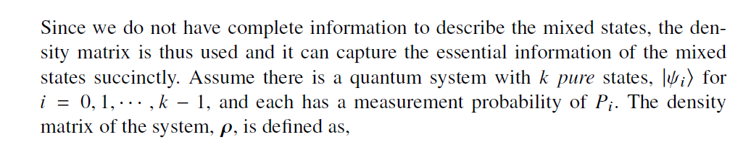
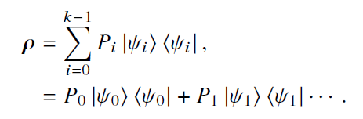
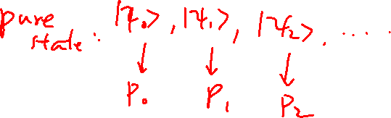
Definition of Density Matrix
From last lecture
Learning outcomes: Definition of density matrix

Slide 7
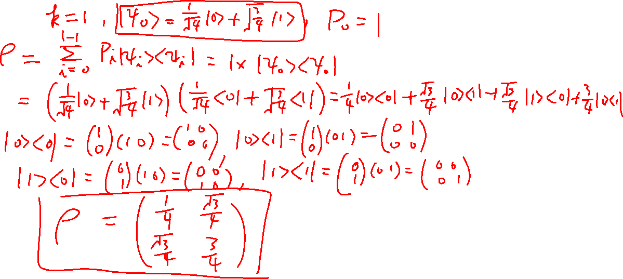
Density Matrix of Pure State
From last lecture
Learning outcomes: Definition of density matrix

Slide 8
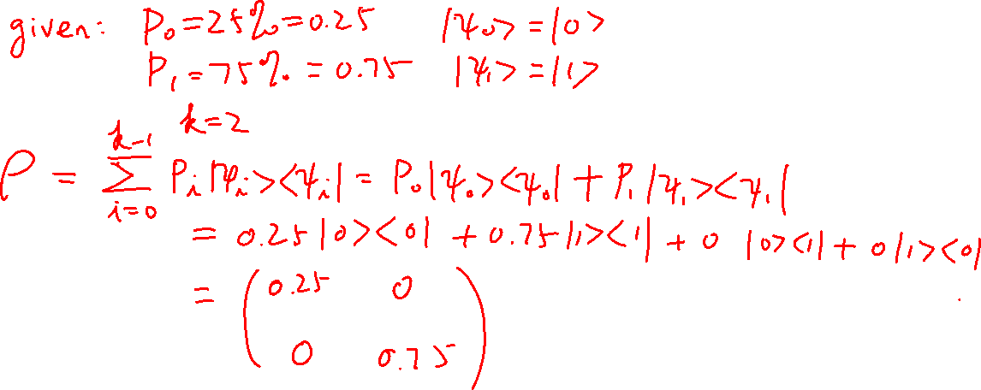
Density Matrix of Mixed State
Learning outcomes: Pure state and mixed state have different density matrices even they have the same measurement probability

Slide 9
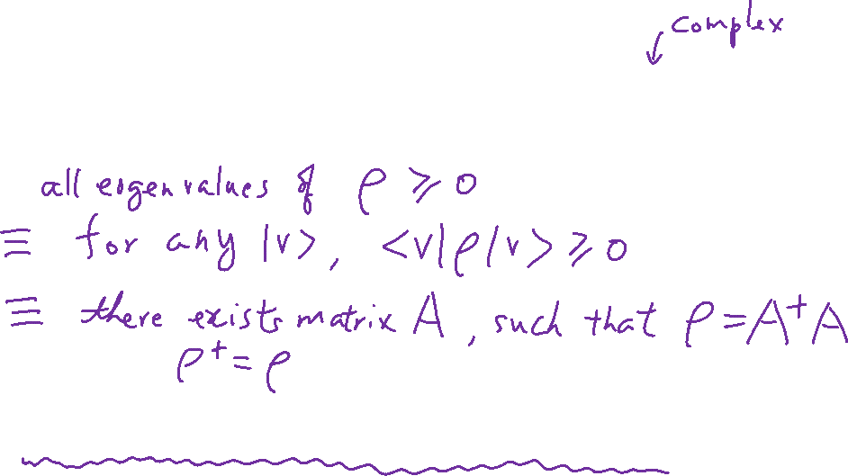
Properties of Density Matrix
Learning outcomes: A good checklist
N×N Matrix: Simplify the description to N² numbers
For pure state, it is more but it gets rid of the phase
Semi-Positive Definite (PSD)
Hermitian
tr(ρ)=1
A matrix is a density matrix if it is PSD and tr(ρ)=1

Slide 10
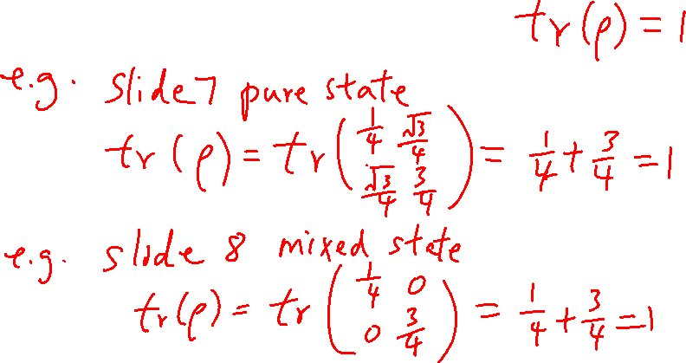
Traces of Density Matrix

Slide 11
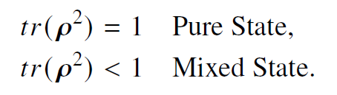
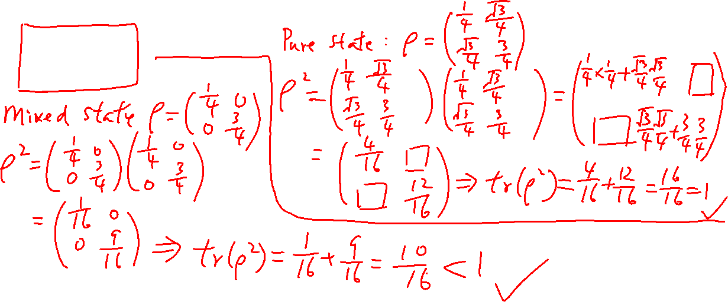
Density Matrix: Check Pure or Mixed State
Learning outcomes: Know how to check if a density matrix corresponds to a pure or mixed state

Slide 12
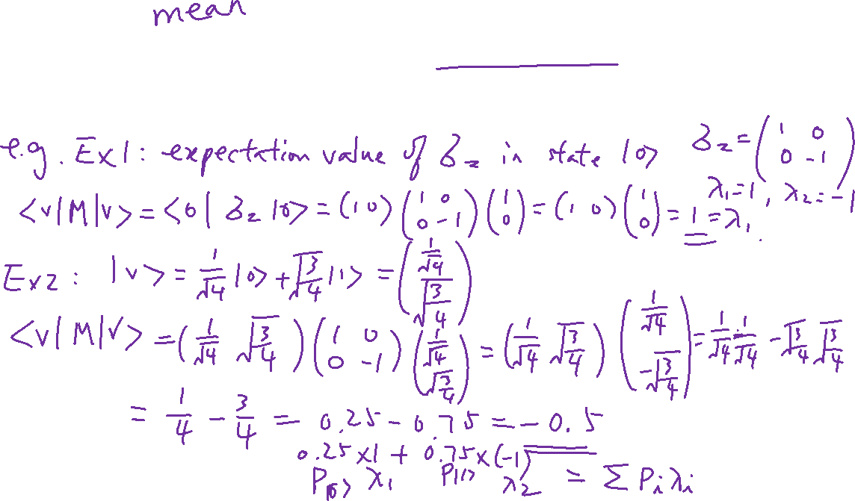
Expectation Value: of a Pure State
Learning outcomes: Find the expectation value of an operator of a given state

Slide 13
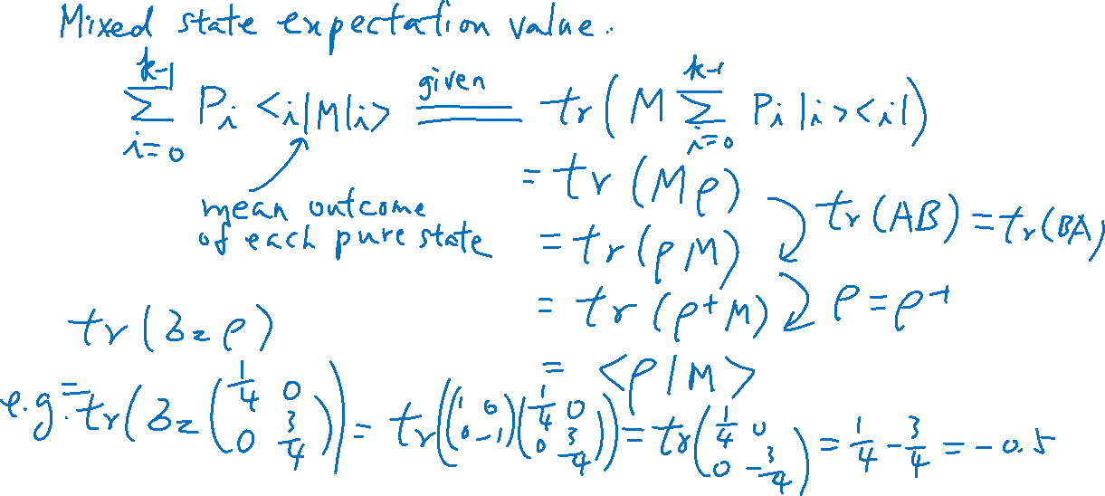
Motivation of Density Matrix
Learning outcomes: Just need to appreciate the motivation

Slide 14
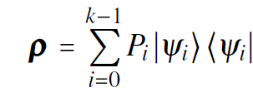
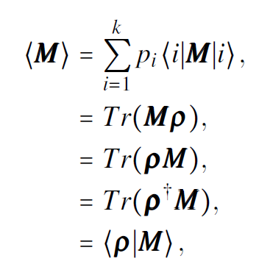
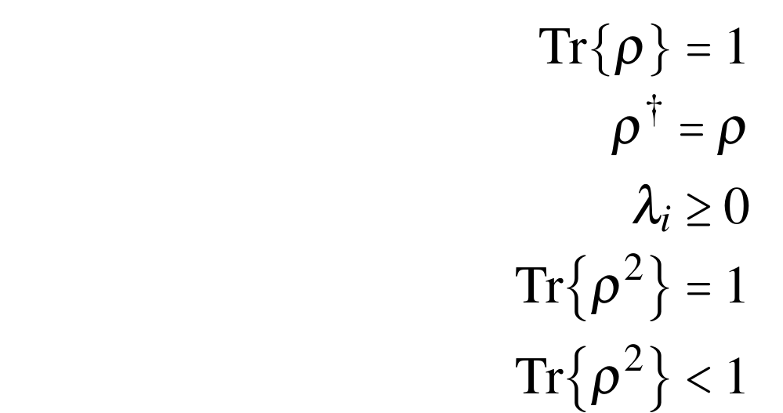
Summary
Density Matrix
Properties of Density Matrix
Expectation Value
Pure state
Mixed state

Slide 15
State on Bloch Sphere
Chapters 5, 6 of “Quantum Computing Architecture and Hardware for Engineers: Step by Step”
Introduction to Quantum Computing From a Layperson to a Programmer in 30 Steps – YouTube
https://www.youtube.com/playlist?list=PLnK6MrIqGXsJfcBdppW3CKJ858zR8P4eP

Slide 16
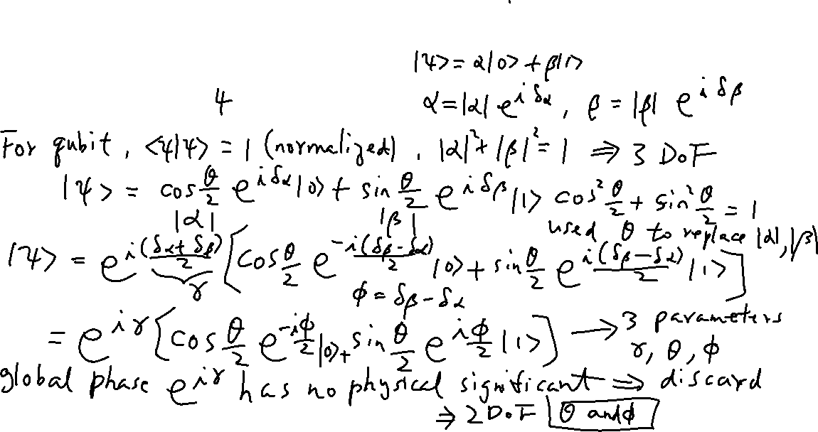
Bloch Sphere
Learning outcomes: Bloch sphere is the embedding of the 2D complex space in a real 3D space. The global phase is ignored.
A convenient way to represent qubit in real 3D space
2D complex vector space mapped to 3D unit vector space
Degrees of Freedom: DOF = ?

Slide 17
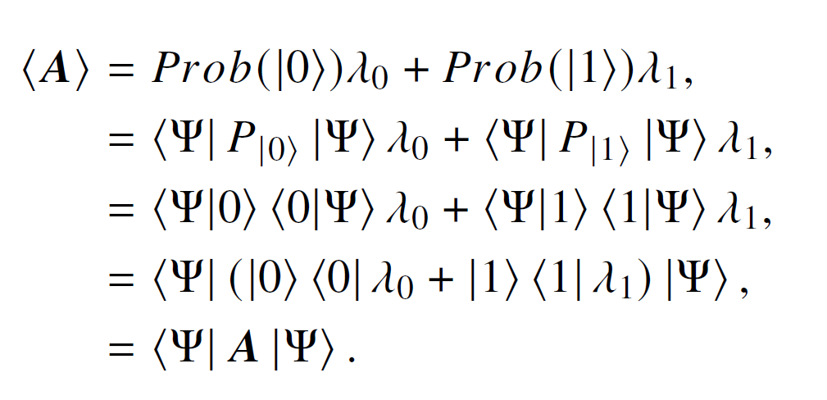
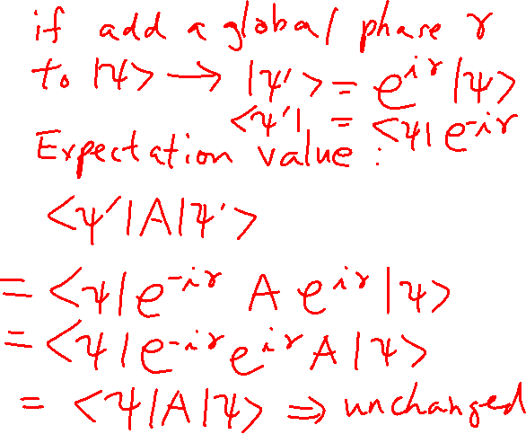
Expectation Value of Measurement using Projection Operator
From lecture 5

Slide 18
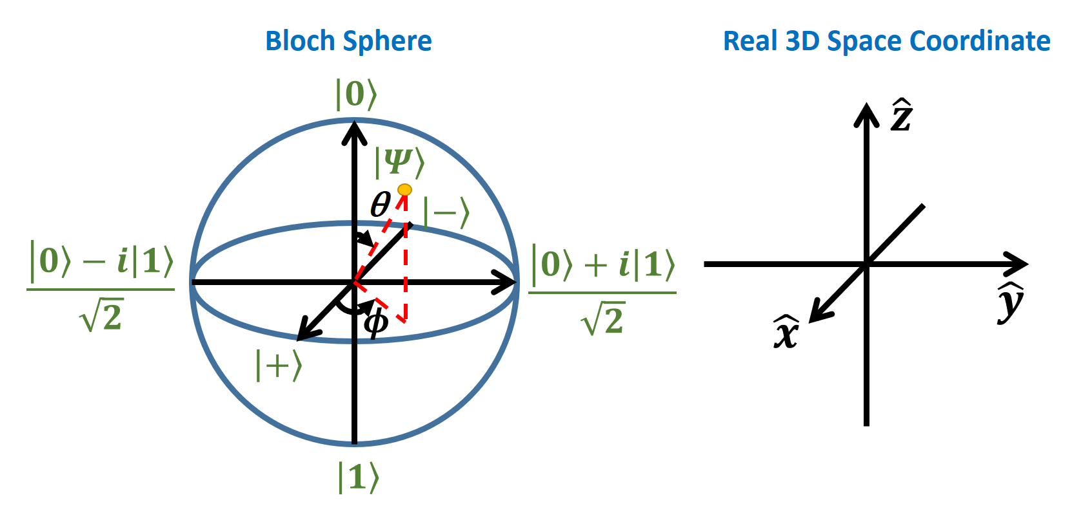
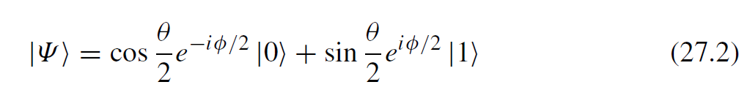
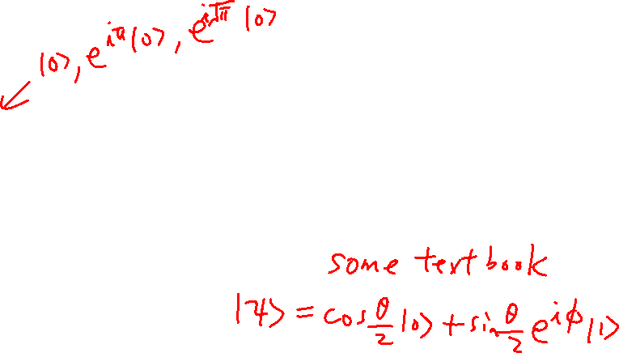
Embedding C² space in 3D space
Learning outcomes: Bloch sphere is the embedding of the 2D complex space in a real 3D space. The global phase is ignored.
Each point represents an infinite number of states that differ by a global phase.

Slide 19
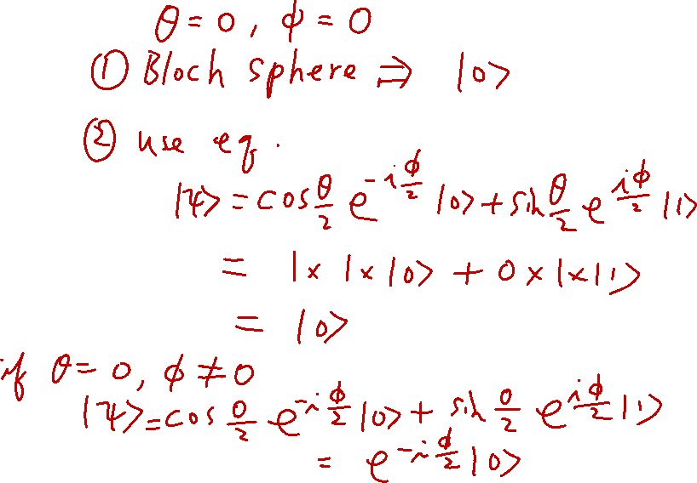
Extrema in Bloch Sphere
Learning outcomes: Able to perform substitutions

